Slide 1
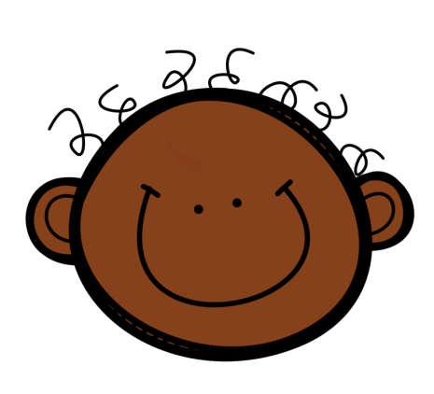
Susan Powers
PYPteachingtools.com
IB PYP
Bulletin Bunting Kit
Editable
©Susan Powers
PYPteachingtools.com

Slide 2
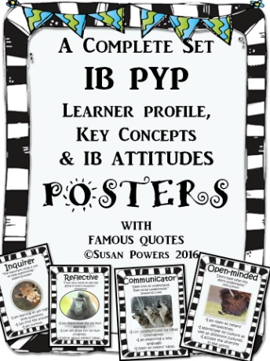
This bright and cheerful IB PYP bunting is perfect for back to school. Add it on your bulletin boards, hang it over your door to welcome your little learners are they walk into their classroom. Hang it around your room. It is versatile, comes in two different sizes, has everything that you need for your IB PYP bulletin boards and comes with an editable format so that you can change it up to suit yourself from year to year. Please note that only the text is editable due to copyright. The pennants themselves are not editable. You will need Power Point programme to edit this material.
Simply copy and fold the top of the bunting over a length of string for an attractive classroom decoration. Or, simply pin to your bulletin board.
Included:
Unit of Inquiry/Enquiry
Action!
Our Learner Profile
Key Concepts
Welcome
Skills
If you like these materials, you may also be interested in my cute IB PYP posters that come in various packs suitable for little kids and the big kids, including a black and white set to match this bunting. There many other back to school inquiry based teaching tools as well as my complete IB PYP units of inquiry, all found in my store .
Enjoy!
Susan Powers
www.pypteachingtools.com

Slide 3
Examples of the bunting signs.
Welcome
Our Learner Profile
Key Concepts
Unit of Inquiry/Enquiry
Action !
Skills
Use the editable pennants to mix n’ match and create your own version.

Slide 4
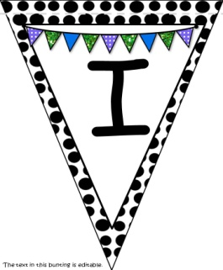

Slide 5
W
The text in this bunting is editable.

Slide 6
E
The text in this bunting is editable.

Slide 7
L
The text in this bunting is editable.

Slide 8
C
The text in this bunting is editable.

Slide 9
O
The text in this bunting is editable.

Slide 10
M
The text in this bunting is editable.

Slide 11
E
The text in this bunting is editable.

Slide 12
U
The text in this bunting is editable.

Slide 13
N
The text in this bunting is editable.

Slide 14
I
The text in this bunting is editable.

Slide 15
T
The text in this bunting is editable.

Slide 16
OF
The text in this bunting is editable.

Slide 17
I
The text in this bunting is editable.

Slide 18
E
The text in this bunting is editable.

Slide 19
N
The text in this bunting is editable.

Slide 20
Q
The text in this bunting is editable.

Slide 21
U
The text in this bunting is editable.

Slide 22
I
The text in this bunting is editable.

Slide 23
R
The text in this bunting is editable.

Slide 24
Y
The text in this bunting is editable.

Slide 25
S
The text in this bunting is editable.

Slide 26
K
The text in this bunting is editable.

Slide 27
I
The text in this bunting is editable.

Slide 28
L
The text in this bunting is editable.

Slide 29
L
The text in this bunting is editable.

Slide 30
S
The text in this bunting is editable.

Slide 31
O
U
The text in this bunting is editable.

Slide 32
R
L
The text in this bunting is editable.

Slide 33
E
A
The text in this bunting is editable.

Slide 34
R
N
The text in this bunting is editable.

Slide 35
E
R
The text in this bunting is editable.

Slide 36
P
R
The text in this bunting is editable.

Slide 37
O
F
The text in this bunting is editable.

Slide 38
I
L
The text in this bunting is editable.

Slide 39
E
*
The text in this bunting is editable.

Slide 40
K
E
The text in this bunting is editable.

Slide 41
Y
C
The text in this bunting is editable.

Slide 42
O
N
The text in this bunting is editable.

Slide 43
C
E
The text in this bunting is editable.

Slide 44
P
T
The text in this bunting is editable.

Slide 45
S
!
The text in this bunting is editable.

Slide 46
A
The text in this bunting is editable.

Slide 47
C
The text in this bunting is editable.

Slide 48
T
The text in this bunting is editable.

Slide 49
I
The text in this bunting is editable.

Slide 50
O
The text in this bunting is editable.

Slide 51
N
The text in this bunting is editable.

Slide 52
!
The text in this bunting is editable.

Slide 53
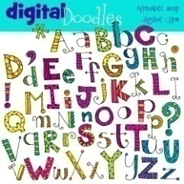
The Credits:
Thanks to the following creative folks.
Find more tips and tools on my blog
www.pypteachingtools.com
Let’s keep in touch!
Find me on Instagram @pypteaching
And to mycutegraphics.com

